Slide 1












International Data PRIVACY REGULATION (IDPR) Project GuidE: Prof. Swapnil Wani
MEMBERS:
121AX055 SRUSHTI ANIL KULKARNI
121AX061 AYUSH K TIWARI
121AX063 SUSHMITA R YADAV
222AX065 OMKAR B GORDE

Slide 2



01. INTRODUCTION
Data privacy refers to the protection of personal information from unauthorized access and misuse.
It ensures that individuals' data is collected, stored, and used in accordance with privacy laws and regulations.
AES (Advanced Encryption Standard) is a symmetric encryption algorithm used to securely encode data.
Known for its strength and efficiency, widely used in government, military

Slide 3


02. PROBLEM STATEMENT
Privacy Risks: Increased personal data collection heightens the risk of breaches.
Compliance Issues: Organizations face challenges with varying international privacy laws.
Framework Gap: A standardized data privacy framework is needed for better protection and control.

Slide 4
03. LITERARTURE SURVEY: PAPER 1
On the Evaluation of Privacy Impact Assessment and Privacy Risk Assessment Methodologies:
A Systematic Literature Review
YEAR | 2024
AUTHORS | Samuel Wairimu; Leonardo Horn Iwaya; Lothar Fritsch; Stefan Lindskog
PROBLEM ADDRESSED | The problem addressed is the insufficient systematic evaluation and validation of Privacy Impact Assessments (PIAs) and Privacy Risk Assessments (PRAs). Although these methodologies are crucial for assessing and mitigating privacy risks, they often lack rigorous scientific validation and evidence of effectiveness in practical applications. This gap impedes the ability to adopt and implement privacy-by-design practices effectively, highlighting the need for more comprehensive and evidence-based evaluations of these privacy methodologies.
GAP | The gap identified is the lack of rigorous and systematic evaluation of Privacy Impact Assessments (PIAs) and Privacy Risk Assessments (PRAs). Most methodologies lack comprehensive scientific validation and are primarily supported by limited case-specific studies, hindering their practical effectiveness and widespread adoption.

Slide 5
PAPER 2
Privacy Engineering in the Wild: Understanding the Practitioners’ Mindset, Organizational Aspects, and Current Practices
YEAR | 2023
AUTHORS | Leonardo Horn Iwaya; Muhammad Ali Babar; Awais Rashid
PROBLEM ADDRESSED | The problem addressed is the lack of practical understanding of how privacy engineering is applied in the industry. The paper explores software practitioners' perspectives and practices to identify gaps in implementing privacy engineering components and highlights the need for better alignment between privacy values, organizational culture, and education in privacy engineering.
GAP | The paper does not address quantitative aspects of privacy engineering or provide a detailed analysis of implementation challenges. It also lacks a comparative study of privacy practices across different industries or regions beyond the sample of 30 practitioners.

Slide 6
PAPER 3
A Survey on Privacy Properties for Data Publishing of Relational Data
YEAR | 2020
AUTHORS | Athanasios Zigomitros; Fran Casino; Agusti Solanas; Constantinos Patsakis
PROBLEM ADDRESSED | The paper addresses the challenge of protecting individual privacy in the face of advanced data mining and fusion techniques that can re-identify individuals even after direct identifiers are removed. It provides an overview of current privacy-preserving methods and discusses their effectiveness, limitations, and future research directions.
GAP | The paper does not address the implementation challenges or practical limitations of privacy-preserving methods in real-world scenarios. Additionally, it lacks an exploration of the impact of emerging technologies on privacy-preserving techniques and does not provide a detailed comparison of their effectiveness across different domains.

Slide 7
PAPER 4
Integrating Technical and Legal Concepts of Privacy
YEAR | 2018
AUTHORS | Ana Sokolovska; Ljupco Kocarev
PROBLEM ADDRESSED | The paper addresses the challenge of integrating legal and technical concepts of privacy protection, highlighting the differences between EU and US approaches. It discusses the need to balance ambiguous legal definitions with precise technical measures, data utility, and the complexity of implementing privacy-by-design frameworks.
GAP | The paper does not address the specific implementation challenges of integrating differential privacy with legal requirements in practice. Additionally, it lacks a detailed exploration of how emerging technologies might impact the convergence of legal and technical privacy frameworks.

Slide 8
PAPER 5
Beware: Processing of Personal Data—Informed Consent Through Risk Communication
YEAR | 2024
AUTHORS | Lukas Seiling; Rita Gsenger; Filmona Mulugeta; Marte Henningsen; Lena
PROBLEM ADDRESSED | The paper addresses the challenges of effective risk communication under the GDPR by proposing a model for context-independent risk communication in the processing of personal data. It identifies relevant information categories, specific adverse consequences, and strategies for risk mitigation, based on a systematic qualitative content analysis and expert interviews. The results aim to enhance how risk information is communicated to data subjects, improving their ability to make informed consent decisions.
GAP | The paper does not explore the effectiveness of the proposed risk communication model in real-world scenarios or how it can be applied across different industries. It also does not address potential barriers to adopting the model within existing regulatory and organizational frameworks.

Slide 9

04. PROPOSED SYSTEM
Data Access: Securely retrieve data
using encrypted communication and
user authentication.
Data Storing: Encrypt and securely store data in a MySQL database with access controls and backups.
Data Submit: Decrypt and provide secure access to data through controlled interfaces with robust logging.

Slide 10
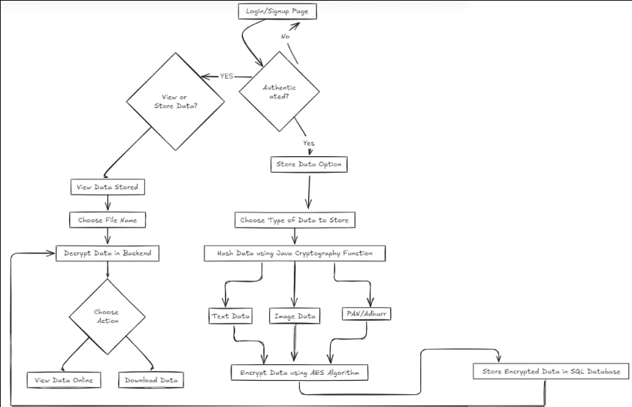

Slide 11
Technologies Used:
- Java: A powerful programming language for backend development.
- MERN Stack: A versatile framework for building web applications.
- APIs: Facilitate secure data exchange with third-party services.
- SQL: Enables efficient CRUD operations on databases.
Software Utilized:
- Visual Studio: Integrated development environment for coding.
- JDK (Java Development Kit): Essential toolkit for Java development.
- Official API Platform for Government ID Verification: For reliable identity validation

Slide 12
05. METHODOLOGY
FRONTEND
DATA ACCESS
01
02
PROVIDE UI/UX TO USERS
ACCESS DATA
DATA STORING
DATA SUBMIT
03
04
STORE IT SECURELY
PROVIDE THE DATA WHEN REQUIRED

Slide 13
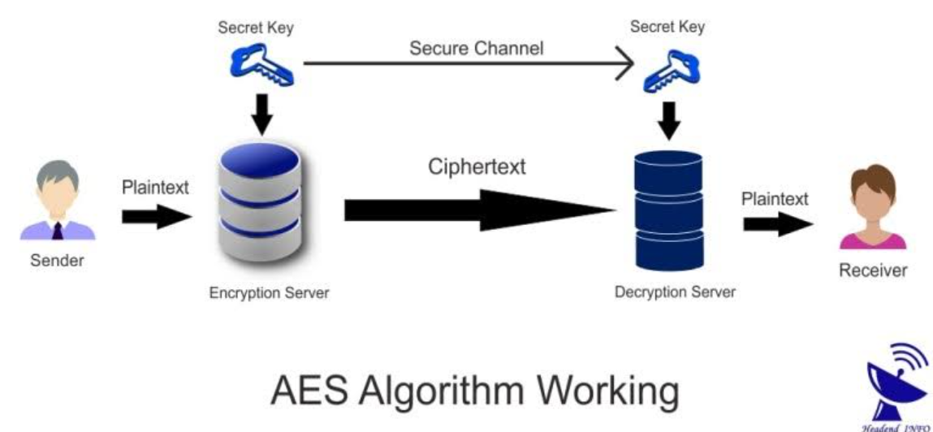

Slide 14


06. IMPLEMENTATION

Slide 15
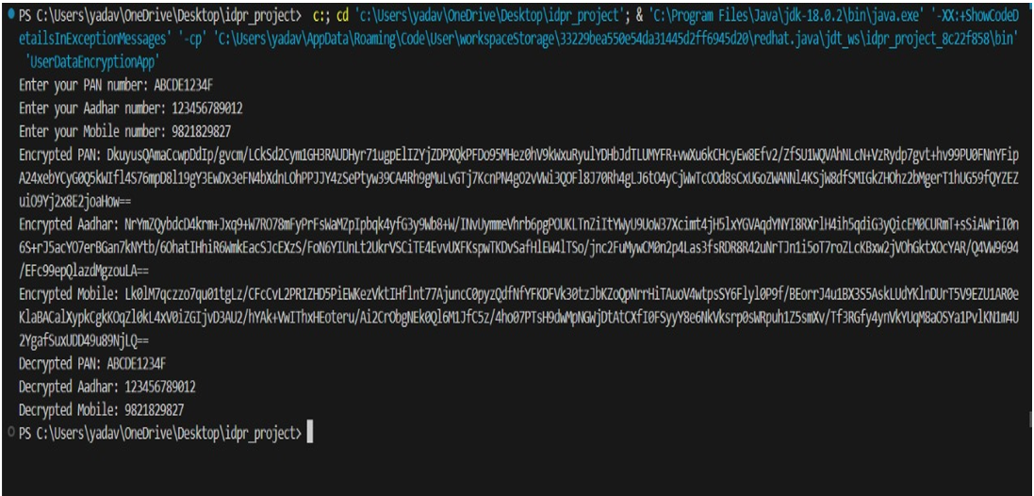
06. IMPLEMENTATION

Slide 16
07. RESULT
Regulatory Compliance: Adheres to GDPR, CCPA, and other international data privacy laws.
Data Security: Uses asymmetric 256-bit encryption for protecting sensitive information.
Efficient Handling: Employs MySQL for secure and efficient data storage.
Support: Includes ongoing maintenance and updates.

Slide 17
08. CONCLUSION
Data Privacy Compliance: The IDPR project successfully provides a secure and compliant framework for handling sensitive personal data, aligning with international privacy regulations like GDPR and CCPA.
Enhanced Security: By implementing 256-bit asymmetric encryption, the project ensures that sensitive information is safeguarded against breaches and unauthorized access.
Scalability and Adaptability: The system is designed to adapt to future regulatory changes and can be scaled to accommodate different types of data and larger databases.
Future Improvements: Continuous monitoring and updates can be applied to stay in line with evolving data privacy laws and technological advancements in encryption and security.

Slide 18
THANKS!

